Slide 1
CDC – Fraud Detection Demo
Oracle Financial Services Consulting
December, 2020

Slide 3

Agenda
1
How are we working with our clients on their digital platform journey?
2
CDC Fraud Detection: Use Case
Problem Statement
Approach/Solution
CDC Features: User Story, Demo
3
Next Steps

Slide 4



How are we working with our clients on their digital platform journey?
‘Product Mindset’ Approach
Discover
Design
Development
Delivery
Understand the digital platform vision, business drivers Discover the current and future state Define the Digital Platform Implementation Roadmap Discover right technologies and solutions by building POTs/MVPs | Domain Driven Design Micro-service Architecture Evolve Microservices Canvas API Strategy Problem Space Definition Teams by Domain responsibility Day 0 Automation Strategy | Small, Agile, Autonomous teams Identify Technology Frameworks Abstract Cloud Services Create Development Platform Adopt 12 Factor Principles | 3 Standard Phases – CI, CD-D Industry Standard Tools Adaptation of Best Practices
Containerized Proven Architecture | Optimized Teams Rapid Delivery | Satisfied Customer

Slide 5
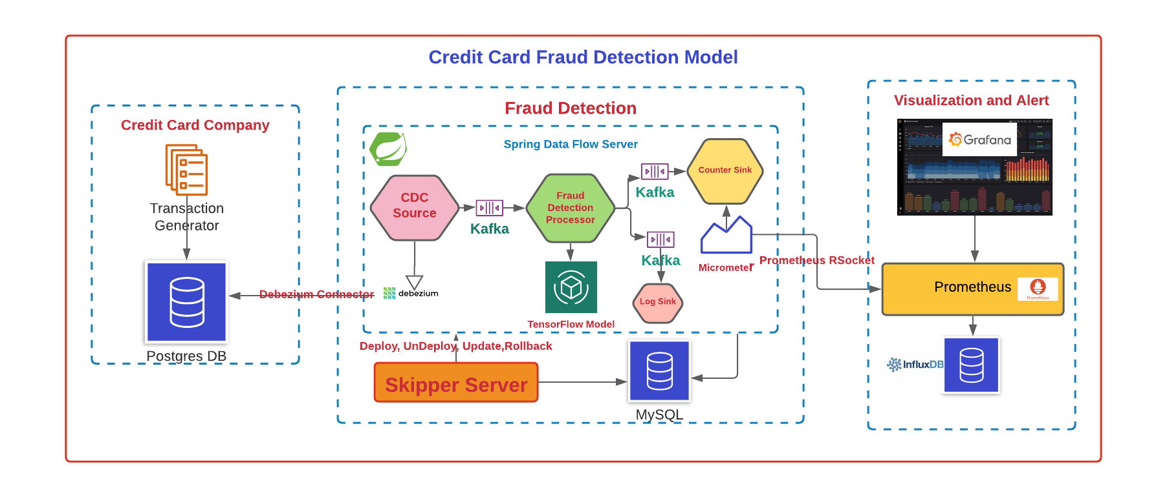
Credit Card Fraud Detection Using CDC
Problem Statement :
Build Dashboard for real time data analytics platform using credit card transactions.
Key aspects to be accounted for in “Design /Solution”:
Debezium – for CDC
TensorFlow Model - Data analyses
Micrometer
Prometheus
Grafana
Postgres (Database)
MySQL
Influx DB
Kafka
Spring Cloud Data Flow Server on top of
Skipper Server
Notes:
Independent development and freedom to choose technology – Developers can work on different microservices at the same time and choose the best technologies for the problem they are solving.
Independent deployment and release cycle – Microservices can be updated individually on their own schedule.
Granular scaling – Individual microservices can scale independently, reducing the overall cost and increasing reliability.
Simplicity – Smaller services are easier to understand which expedites development, testing, debugging, and launching a product.
Fault isolation – Failure of a microservice does not have to translate into failure of other services.

Slide 7
Credit Card Fraud Detection Using CDC
Solution :
Build solution to capture data change events with Debezium.
Built an application to address the issue in predictive analyze on real time change.
Address the issue related to dynamic model change for data analysis with Tensor flow model.
TensorFlow model which has ML algorithm to analysis the time series data to capture data anomalies.
Easy integration with Spring Cloud Dataflow, Skipper and Kubernetes without any impact to the existing time proven legacy business systems.
Fraud-Detection: Product Features
#1: CDC (Change Data Capture) Debezium.
#2:Spring Cloud Dataflow Data Pipeline for streaming application to analyze real time data. Build Real time interactive dashboard.
#3: TensorFlow Model to implement Predictive analytics.
#4: Prometheus and Grafana : Prometheus stores our metric data in time series in memory and Grafana provides a rich UI to monitor data
Notes:
Independent development and freedom to choose technology – Developers can work on different microservices at the same time and choose the best technologies for the problem they are solving.
Independent deployment and release cycle – Microservices can be updated individually on their own schedule.
Granular scaling – Individual microservices can scale independently, reducing the overall cost and increasing reliability.
Simplicity – Smaller services are easier to understand which expedites development, testing, debugging, and launching a product.
Fault isolation – Failure of a microservice does not have to translate into failure of other services.

Slide 8
Discovery
Objectives : Overall objectives to be achieved on CDC Fraud-Detection
Conducted the discovery phases to
Business Aspect
Pain Points of customers/current challenges
What services and experiences business wants to provide to customer
Application Aspect
Understand functional and technical landscape
Determine Functional Gaps & Technical challenges
Establish Functional Architecture for its implementation
Engineering Aspect
Design, Develop & Deliver
Abstract the complexities of platform from the developers
Best Practices
Technology Aspect
Compute
Data
Messaging
Notes:
Independent development and freedom to choose technology – Developers can work on different microservices at the same time and choose the best technologies for the problem they are solving.
Independent deployment and release cycle – Microservices can be updated individually on their own schedule.
Granular scaling – Individual microservices can scale independently, reducing the overall cost and increasing reliability.
Simplicity – Smaller services are easier to understand which expedites development, testing, debugging, and launching a product.
Fault isolation – Failure of a microservice does not have to translate into failure of other services.

Slide 9
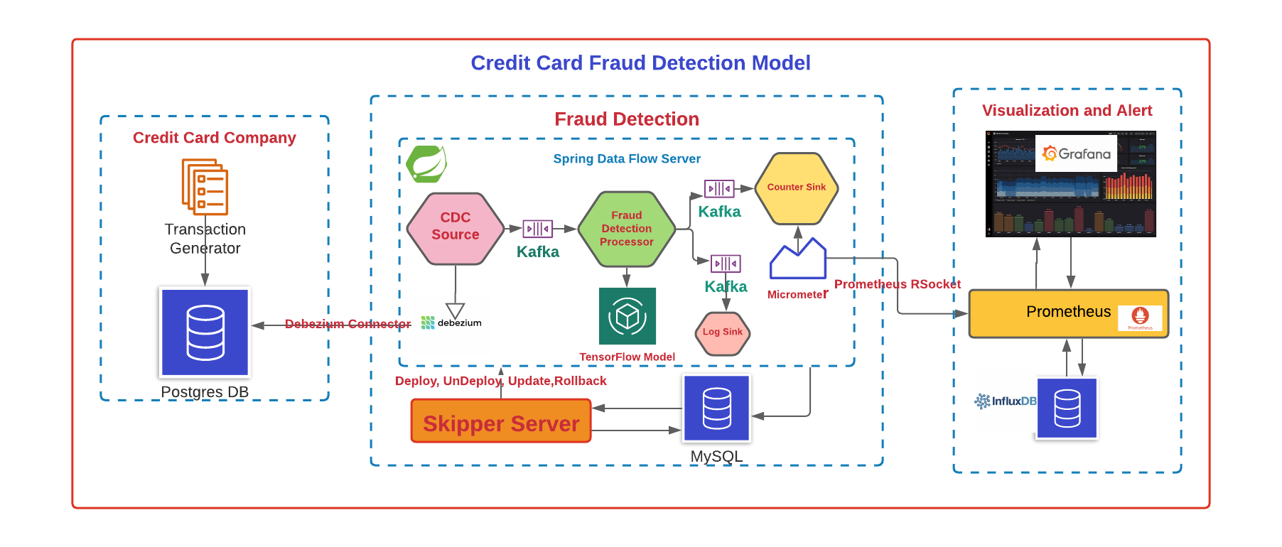
Credit Card Fraud Detection Using CDC
Reference Architecture
Notes:
Independent development and freedom to choose technology – Developers can work on different microservices at the same time and choose the best technologies for the problem they are solving.
Independent deployment and release cycle – Microservices can be updated individually on their own schedule.
Granular scaling – Individual microservices can scale independently, reducing the overall cost and increasing reliability.
Simplicity – Smaller services are easier to understand which expedites development, testing, debugging, and launching a product.
Fault isolation – Failure of a microservice does not have to translate into failure of other services.

Slide 10
Feature #1: Change Data Capture
CDC-Debezium
Logical Solution
Technical Solution
Technical implementation on Reference Architecture

Slide 11
Feature #1: Change Data Capture
CDC - Debezium
In databases, change data capture (CDC) is a set of software design patterns used to determine and track the data that has changed so that action can be taken using the changed data
CDC Methods
Date Modified
Differences values
Trigger
Transaction Log Based Data Capture
Credit card transaction persisted in Postgresdb that generates the change data capture event with help of Debezium connector CURD operation occurs.
Note:
Debezium Supported Connectors
MongoDB
MySQL
PostgreSQL
SQL Server
Oracle (Incubating)
Db2 (Incubating)
Cassandra (Incubating
.

Slide 12
Date Modified
The most recent modified records are retrieved with help DATE_MODIFIED column.
It work well for tradition data warehouse application that are populated using ETL jobs.
To capture DELETE event is challenge as there is no DATE_MODIFIED for deleted rows.
DATE_MODFIED column should be there for all tables.
DATE_MODIFIED to be indexed to lower the impact of performance in the select statement.

Slide 13
Difference method
Compare the current state of the date with previous state of data.
Need lot of resources to determine the difference between the data.
Resource consumption would grow linearly with growth of data.
This method can not be used for real time tracking.

Slide 14
Trigger
CDC performed with shadow table.
Shadow table may store entire row to keep track of every single column change.
Or Primary key is stored along with operation type such as insert, update and delete.
Trigger and storing data in shadow table introduces overhead and it may increase 100%.
Lot challenges to maintain trigger as trigger has to be modified when source table gets modified.

Slide 15
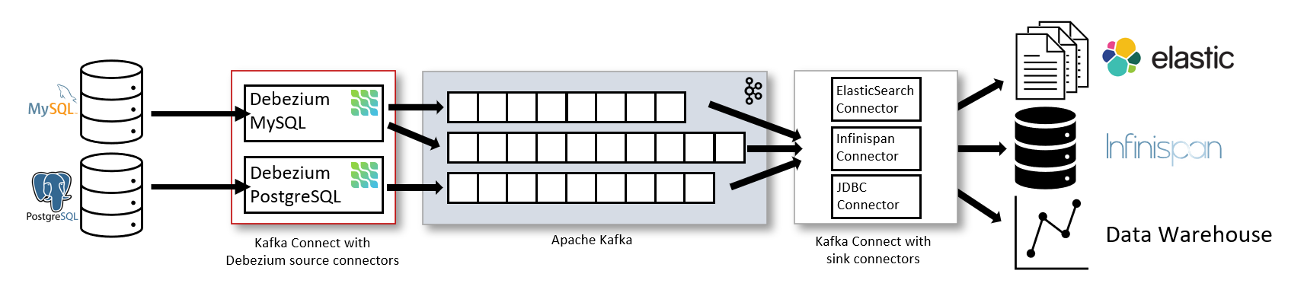
Feature #1: Change Data Capture Logical Solution
PostSQL connector reads data from a logical replication stream.
The data event captured by Debezium connector would be posted into Kafka stream.

Slide 16
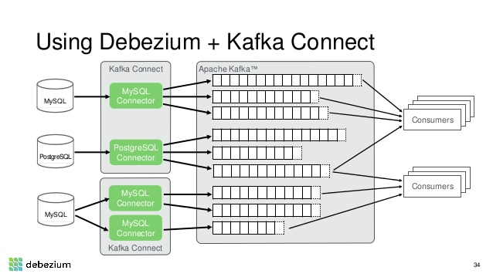
Feature #1: Change Data Capture Technical Solution
Debezium connector point to PostgresDB table.
Connector start responding to all of the inserts, updates, and deletes that other apps commit to your databases.
Debezium is durable and fast, so your apps can respond quickly and never miss an event, even when things go wrong.

Slide 17
CDC Tools in Market
Hevo Data
IBM Infosphere
Qlik Replicate
Talend
Oracle Golden gate
Stream Sets

Slide 18
Feature #1: Change Data Capture Technical Implementation
Transaction Generator
Standalone application that can continuously generate data records compliant with the data format specified in [Credit Card Fraud Detection]
Postgres DB
The data records are generated in random intervals and pushed into a pre-configured Database.
For confidentiality reasons the values of most of the original features, such as `V1`, `V2`, ... `V28` have been anonymized using a principal components obtained with PCA.
Kafka Stream
Event sourcing persists the state of a business entity such an Order or a Customer as a sequence of state-changing events. In this use case on Credit Card Transaction whenever the state of a business entity changes, a new event is appended to the list of events.

Slide 19
Feature #2: Spring Cloud Data Flow
Spring Data Flow Server/Cloud Skipper Server
Logical Solution
Technical Solution
Technical implementation on Reference Architecture

Slide 20
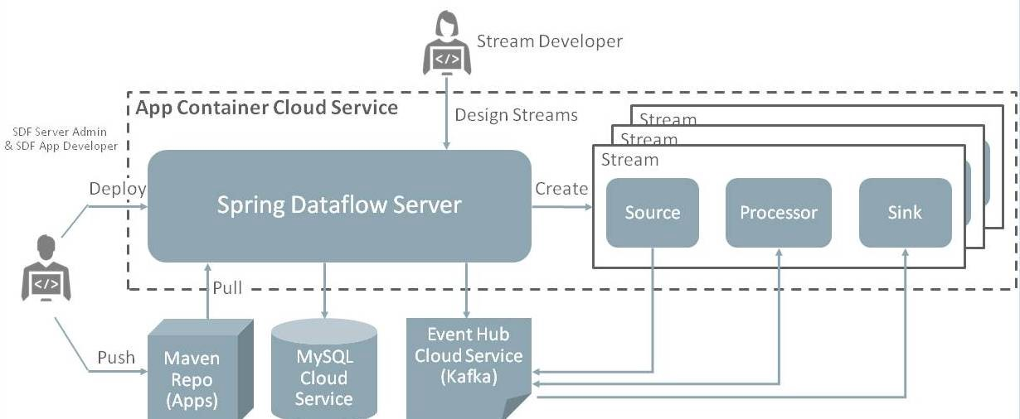
Feature #2: Spring Cloud Data Flow Spring Cloud Data Flow

Slide 21
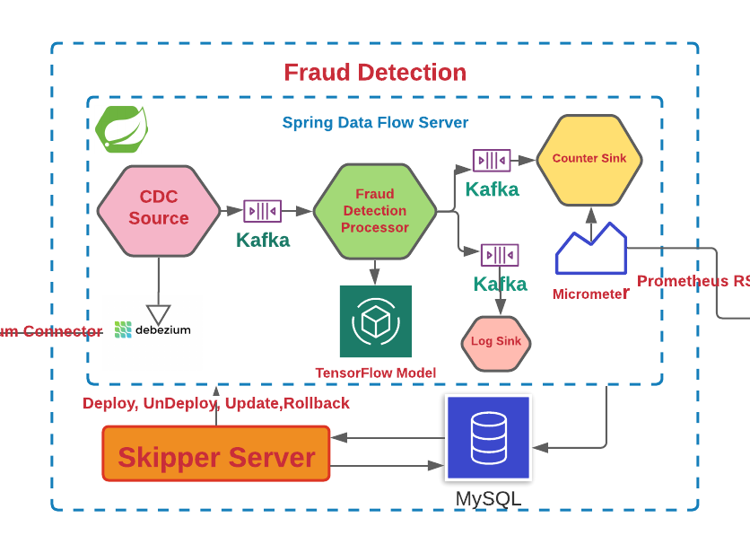
Feature #2: Spring Cloud Data Flow Logical Solution

Slide 22
Feature #2: Spring Cloud Data Flow Technical Solution
CDC Debezium – Source
Micro service
Fraud Detection - Processor
Micro service
Tensor flow model
Pluggable model predictive data analytics
Counter – Sink
Micrometer
Micro service

Slide 23
Feature #2: Spring Cloud Data Flow Technical Solution
Fraud Detection- Processor
Custom Spring Cloud App Starter that extends the TensorFlow Processor to support a specific TensorFlow model build for the Credit Card Detection solution.
Tensor flow is the processor which has ML algorithm to analysis the time series data to capture data anomalies.
Automatically enervates a schema based on underlying data as well as use the schema to inspect out of time datasets.
fraud_detection_graph.pb loaded as resource and it has been used as template to analysis the transaction received from transaction generation.
Identify anomalies, such as missing features, out-of-range values among others.
Detect data drift by looking at a series of data
Technical Stack:
Python
Numpy
Scipy
Pandas
Tensorflow
.

Slide 24
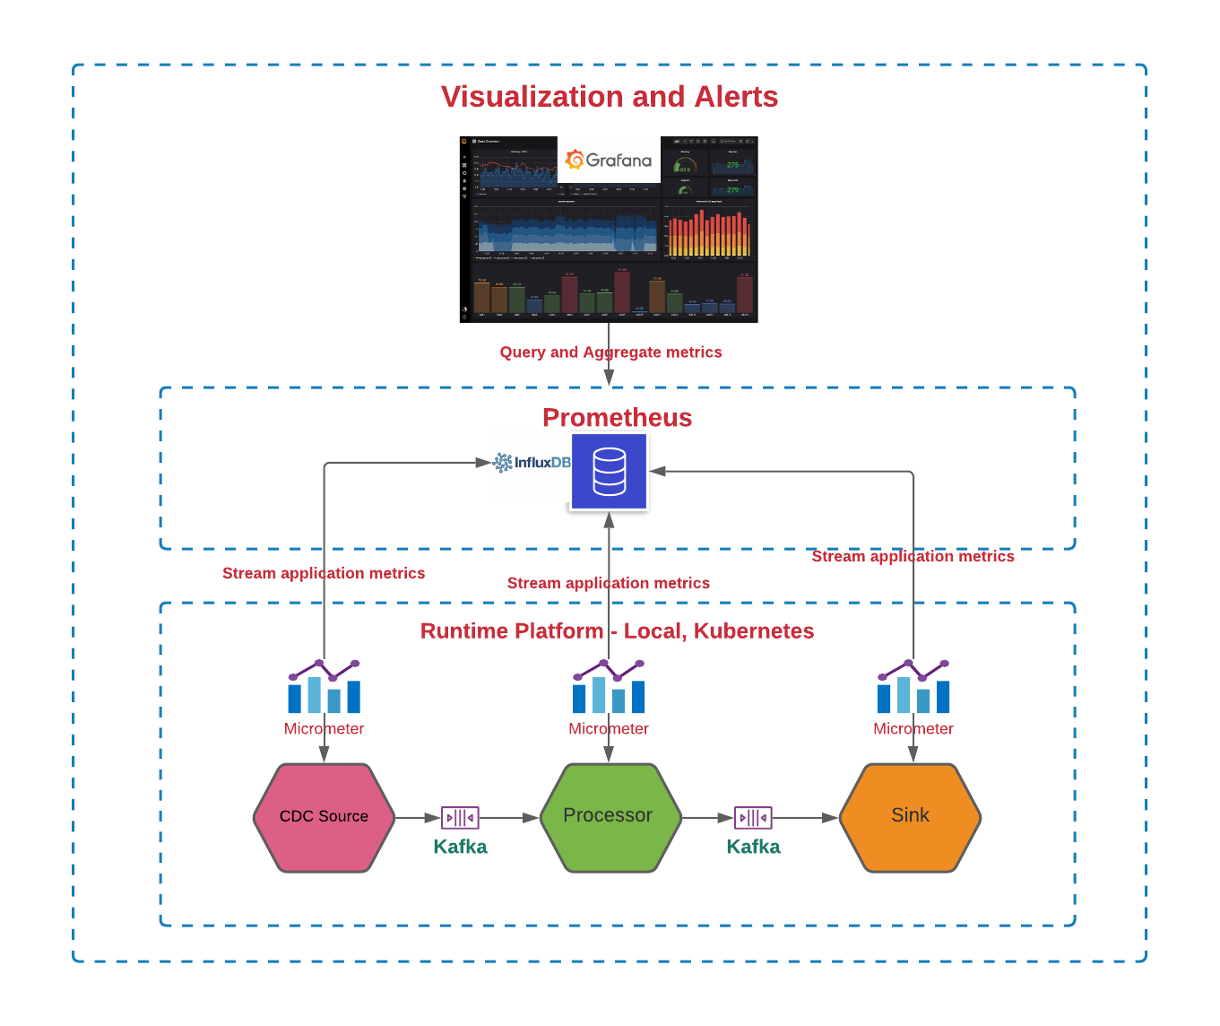
Feature #2: Spring Cloud Data Flow Technical Solution
Technical Stack:
Micrometer
Prometheus
InfluxDB
Grafana
.

Slide 25
Feature #3: Prometheus and Grafana
Prometheus stores our metric data in time series in memory by periodically pulling it via HTTP. The data can be visualized by a console template language, a built-in expression browser, or by integrating Grafana (which we will do after setting up Prometheus).
The included Prometheus browser graph is nice for basic visualization of our metrics but we will use Grafana instead. Grafana provides a rich UI where you create, explore and share dashboards that contain multiple graphs.
Grafana can pull data from various data sources like Prometheus, Elasticsearch, InfluxDB, etc.
InfluxDB is a time series platform — dashboards, queries, tasks and agents all in one place.
InfluxDB empowers developers to build IoT, analytics and monitoring software. It is purpose-built to handle the massive volumes and countless sources of time-stamped data produced by sensors, applications and infrastructure.
Ingest metrics, events and logs in a high-performing time series database capable of ingesting millions of data points per second.
Perform analytics to get faster detection, and resolution, or set up alerts or anomaly detection with a simple click.

Slide 26
Technology Stack
Framework/Platform
Spring boot
Spring data flow
Spring Cloud stream reactive
Spring Cloud Tasks
Tensor flow
Micrometer
Prometheus
Grafana
Debezium
Language
Java
Python
Pandas
Numpy
Database
Postgres
MySQL
Influx DB
Messaging
Kafka

Slide 27
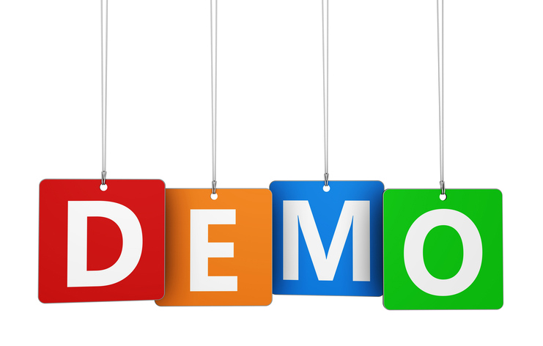
Credit Card Fraud Detection
Demo Time
Notes:
Independent development and freedom to choose technology – Developers can work on different microservices at the same time and choose the best technologies for the problem they are solving.
Independent deployment and release cycle – Microservices can be updated individually on their own schedule.
Granular scaling – Individual microservices can scale independently, reducing the overall cost and increasing reliability.
Simplicity – Smaller services are easier to understand which expedites development, testing, debugging, and launching a product.
Fault isolation – Failure of a microservice does not have to translate into failure of other services.

Slide 28

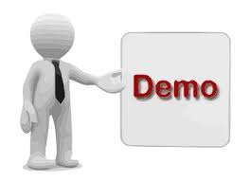

Infrastructure Deployment - AWS
Demo
Demo Components
Terraform
EC2
Spring data flow
Docker
Docker compose
Stream Application Deployment
Notes:
Independent development and freedom to choose technology – Developers can work on different microservices at the same time and choose the best technologies for the problem they are solving.
Independent deployment and release cycle – Microservices can be updated individually on their own schedule.
Granular scaling – Individual microservices can scale independently, reducing the overall cost and increasing reliability.
Simplicity – Smaller services are easier to understand which expedites development, testing, debugging, and launching a product.
Fault isolation – Failure of a microservice does not have to translate into failure of other services.

Slide 29
Credit Card Transaction analyses
Demo
Demo Components
Grafana UI
Credit Card Dashborad import
Spring Data flow
Fraud Detection deployment
Count log deployment
Transaction Generator
Real time Dashboard Display
Computer Vision
Distill actionable information from images
Notes:
Independent development and freedom to choose technology – Developers can work on different microservices at the same time and choose the best technologies for the problem they are solving.
Independent deployment and release cycle – Microservices can be updated individually on their own schedule.
Granular scaling – Individual microservices can scale independently, reducing the overall cost and increasing reliability.
Simplicity – Smaller services are easier to understand which expedites development, testing, debugging, and launching a product.
Fault isolation – Failure of a microservice does not have to translate into failure of other services.

Slide 30
Thank You
Copyright © 2020, Oracle and/or its affiliates | Confidential: Restricted

